Slide 1
CS112: Introduction to Python programming
Week 9: Scipy and Pandas

Slide 2
Numpy复习
https://www.w3ccoo.com/quiztest/quiztest.asp?qtest=NUMPY

Slide 3

SciPy
https://scipy.org/
SciPy is a collection of mathematical algorithms and convenience functions built on the NumPy extension of Python.

Slide 4
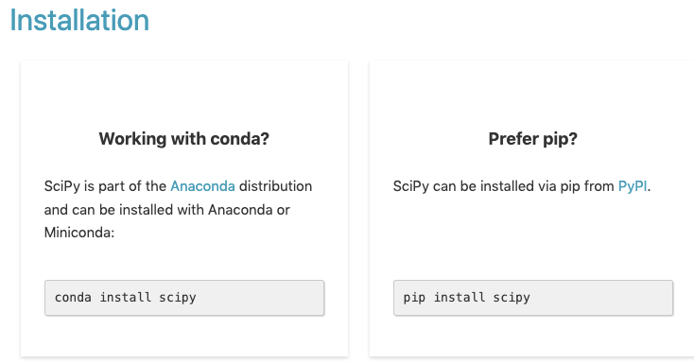
SciPy

Slide 5
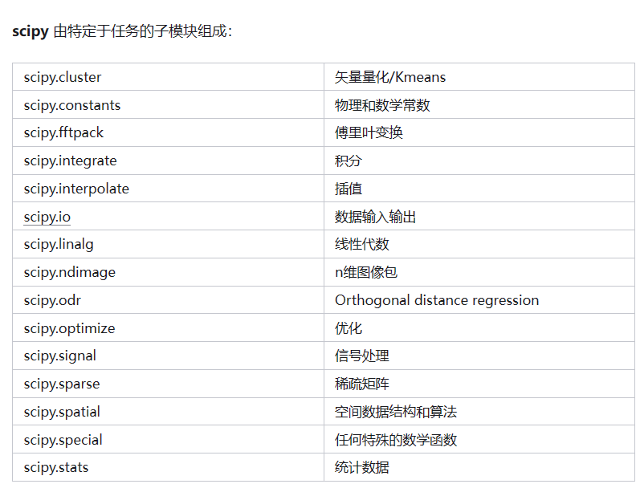
Scipy简介
scipy包含各种专用于科学计算中常见问题的工具箱。其不同的子模块对应不同的应用，如插值、积分、优化、图像处理、统计、特殊函数等
导入 Numpy 和这些 Scipy 模块的标准方法是：
import numpy as np
from scipy import stats

Slide 6
Scipy简介
导入 Numpy 和这些 Scipy 模块的标准方法是：
import numpy as np
from scipy import stats

Slide 7
SciPy Constants
As SciPy is more focused on scientific implementations, it provides many built-in scientific constants.
These constants can be helpful when you are working with Data Science.
from scipy import constants print(constants.pi)
3.141592653589793
# List all constants
print(dir(constants))
https://www.w3schools.com/python/scipy

Slide 8
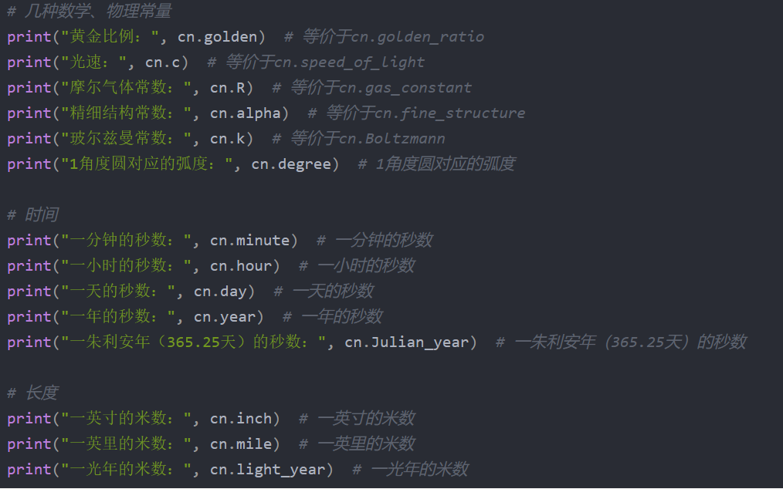
SciPy Constants
import scipy.constants as cn

Slide 9
SciPy & NumPy for Linear Algebra
NumPy and SciPy have extensive tools for numerically solving problems in linear algebra(线性代数)
The SciPy package for linear algebra is scipy.linalg

Slide 10
SciPy & NumPy for Linear Algebra
>>> import scipy.linalg
>>> import numpy as np
>>> a = np.array([[-2, 3], [4, 5]])
>>> scipy.linalg.det(a)
-22.0
>>> b = scipy.linalg.inv(a)
>>> b
array([[-0.22727273, 0.13636364],
[ 0.18181818, 0.09090909]])
>>> np.dot(a, b)
array([[1., 0.],
[0., 1.]])
Matrix determinant
矩阵行列式
Matrix inversion
逆矩阵
Matrix production
矩阵乘法

Slide 11
SciPy & NumPy for Linear Algebra
>>> a.T
[[-2 4]
[ 3 5]]
>>> np.diag(a)
[-2 5]
>>> np.trace(a)
3
Matrix transpose
矩阵转置
Matrix diagonal
矩阵对角线
Matrix trace
矩阵的迹

Slide 12



Solving systems of linear equations
Solving systems of equations is nearly as simple as constructing a coefficient matrix and a column vector
Suppose having the following system of linear equations to solve:
$$Ax=b$$
$$x=A^{−1}b$$

Slide 13
Solving systems of linear equations
>>> A = np.array([[2,4,6], [1,-3,-9], [8,5,-7]])
>>> b = np.array([4, -11, 2])
>>> scipy.linalg.solve(A, b)
array([-8.91304348, 10.2173913 , -3.17391304])
>>> np.dot(scipy.linalg.inv(A), b)
array([-8.91304348, 10.2173913 , -3.17391304])
Using scipy.linalg.solve is faster and numerically more stable than x = A⁻¹b

Slide 14
Scipy 积分和微分方程
SciPy中内置了许多积分与解常微分方程的函数，对于复杂物理问题的数值求解是非常方便的。
本文中使用的SciPy函数都需提前导入SciPy的integrate库，有些地方还需使用NumPy库与Matplotlib。
from scipy import integrate

Slide 15
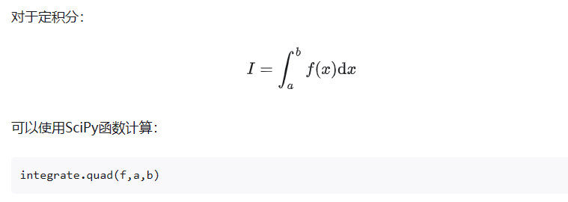
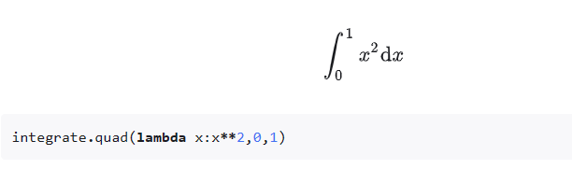
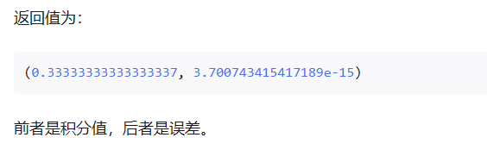
Scipy 定积分

Slide 16
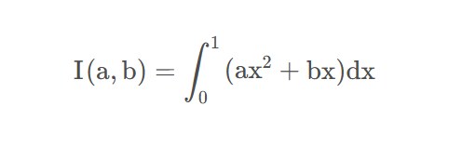
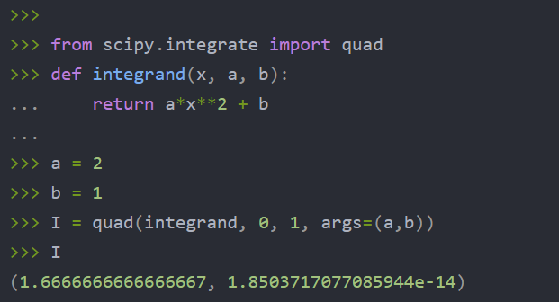
Scipy 定积分
使用函数完成定积分

Slide 17
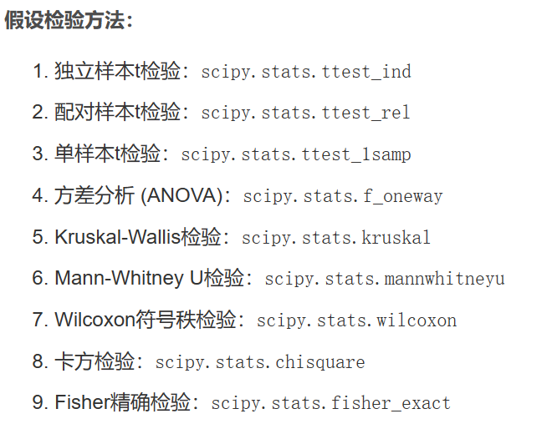
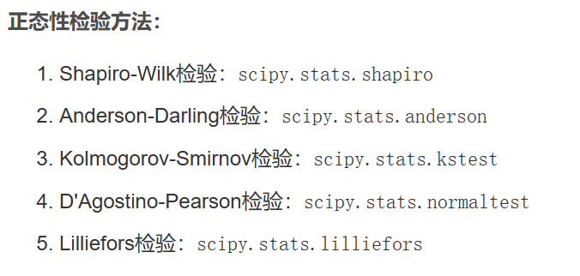
Scipy中的假设检验

Slide 18
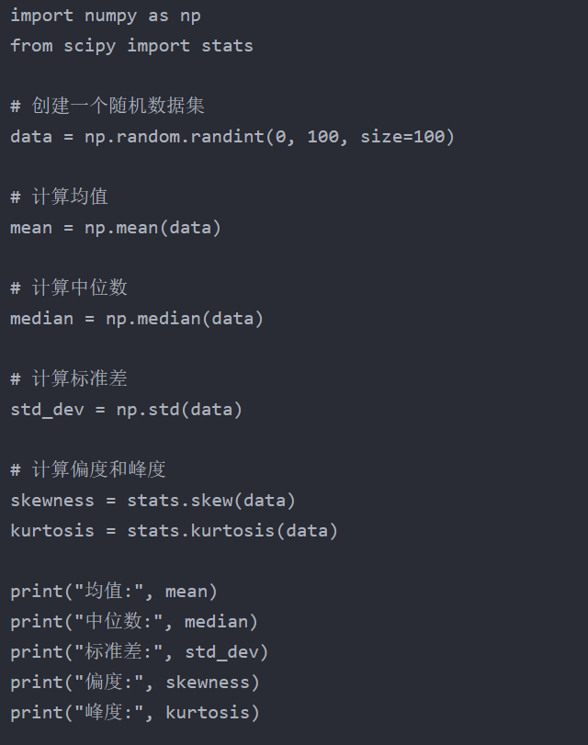
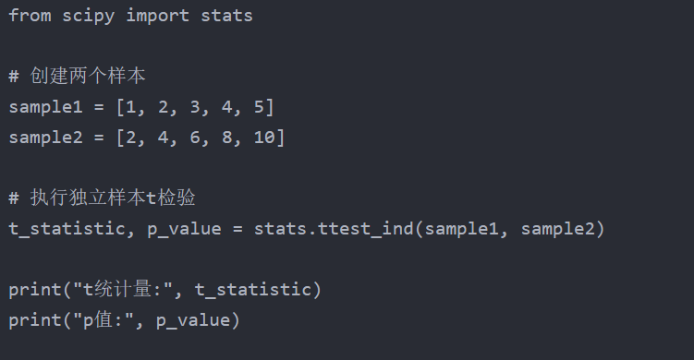
Scipy stats--数据描述与比较
数据描述
2样本均数的统计比较

Slide 19
Scipy stats--卡方检验
使用scipy.stats模块中的chi2_contingency函数来执行卡方检验（Chi-square test）。卡方检验用于检验两个或多个分类变量（组别）之间是否存在显著关联（差异）。
例1：从某中学随机抽取两个班，调查他们对待文理分科的态度，结果，甲班37人赞成，27人反对；乙班39人赞成，21人反对，这两个班对待文理分科的态度是否有显著差异(α= .05)?
from scipy.stats import chi2_contingency
# 例1：构建列联表（二维数组）
observed = [[37,27], [39,21]]
statistic, p_value, dof, expected = chi2_contingency(observed)
# 打印结果
print("Chi-square statistic:", statistic)
print("p-value:", p_value)
print("Degrees of freedom:", dof)
print("Expected frequencies:", expected)

Slide 20
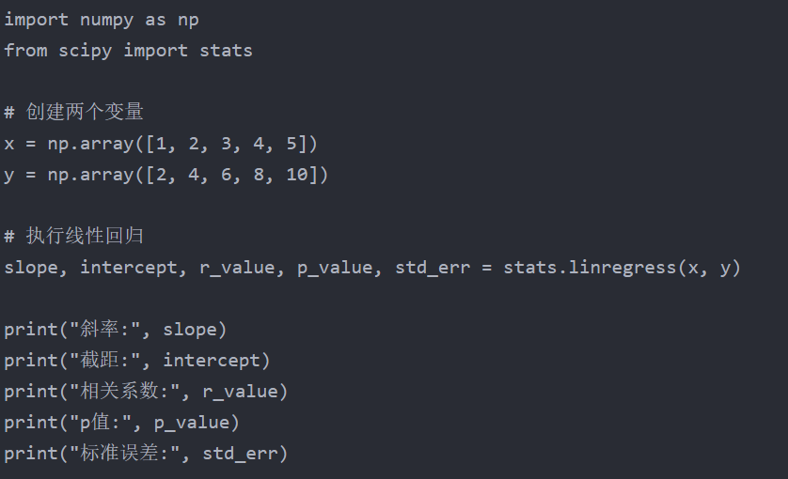
Scipy stats--回归方程
https://docs.scipy.org/doc/scipy/reference/generated/scipy.stats.linregress.html

Slide 21
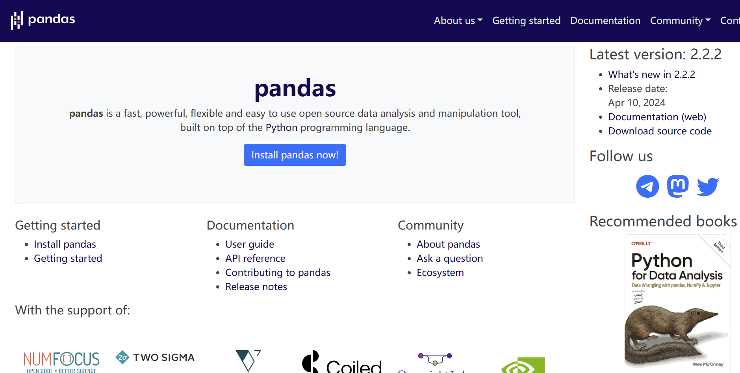
Pandas
pandas is a fast, powerful, flexible and easy to use open source data analysis and manipulation tool, built on top of Numpy.
Install pandas:
conda install pandas
https://pandas.pydata.org/

Slide 22
Pandas-Data Structures
Pandas provides two very useful data structures to process the data:
Series and DataFrame

Slide 23
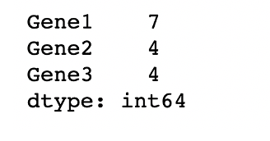
Pandas-Series
Series is a one-dimensional array that can store various data types, including mix data types.
The row labels in a Series are called the index.
Any list, tuple, dictionary and numpy ndarray can be converted into Series using ‘series’ method
The basic method to create a Series is to call:
pd.Series(data, index=index)
index must be the same length as data. If no index is passed, one will be created having values [0, ..., len(data) - 1].

Slide 24
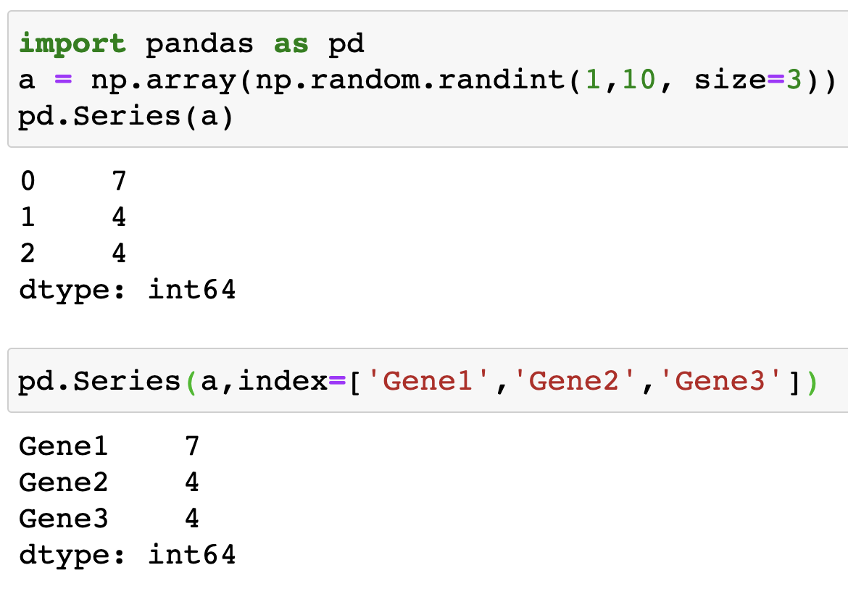
Pandas-Series
From ndarray:

Slide 25
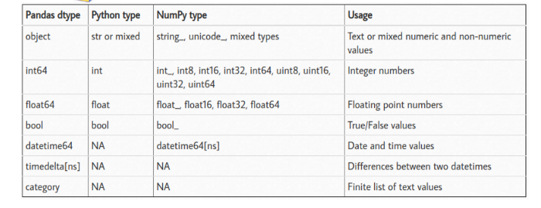
Pandas-dtypes

Slide 26
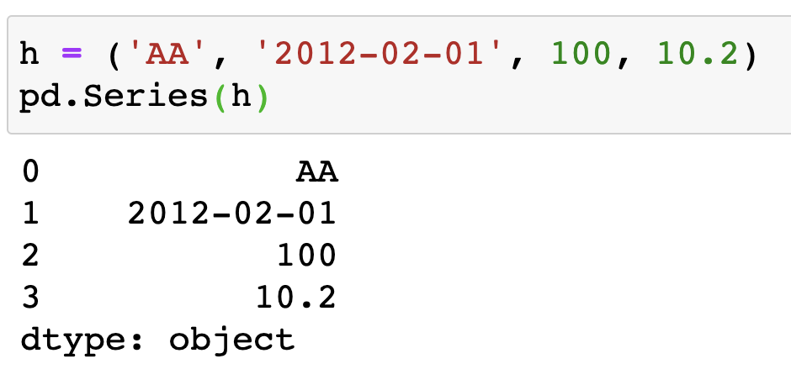
Pandas-Series
From tuples:

Slide 27
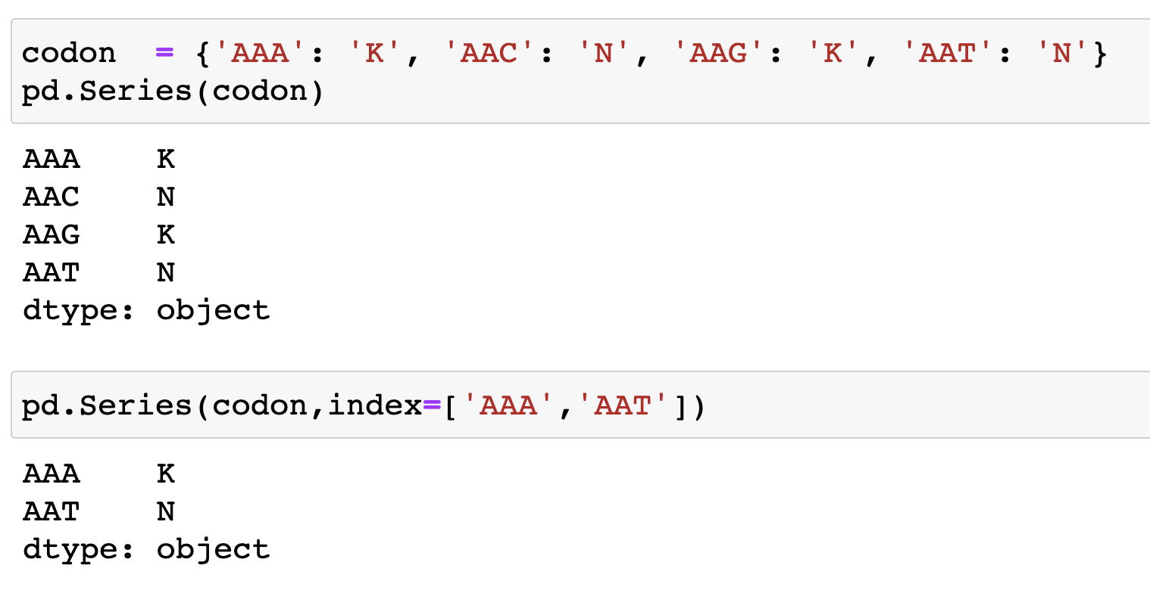
Pandas-Series
From dict:
If an index is passed, the values in data corresponding to the labels in the index will be pulled out.

Slide 28
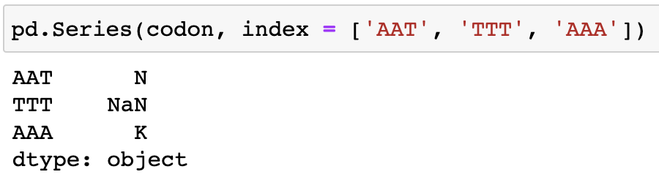
Pandas-Series
From dict:
If a value is not associated for a label, then NaN is printed. NaN (not a number) is the standard missing data marker used in pandas.

Slide 29
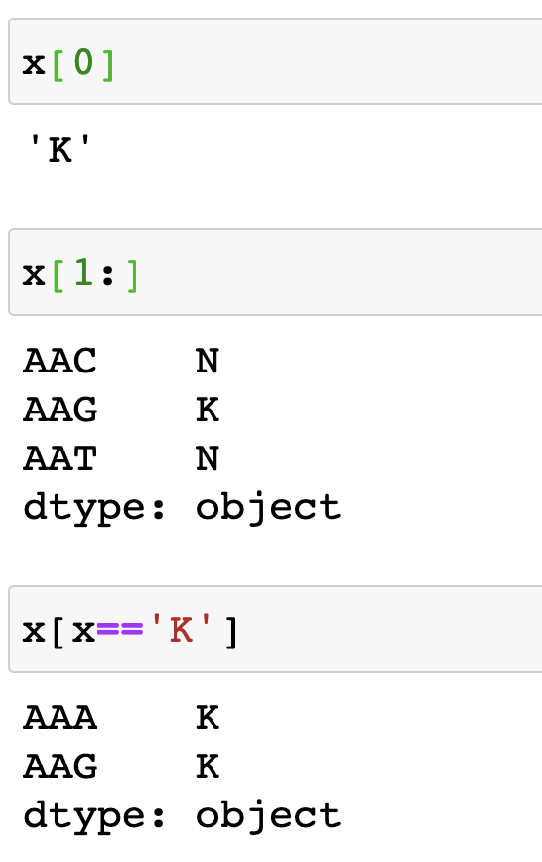
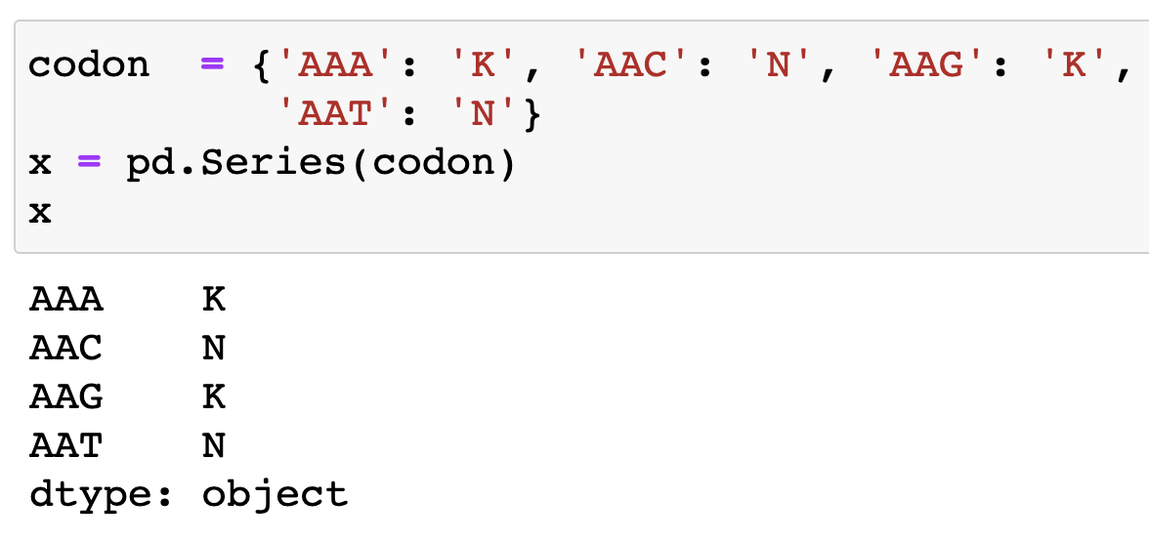
Pandas-Series
Accessing elements in Series:
Series acts very similarly to a ndarray, and is a valid argument to most NumPy functions

Slide 30
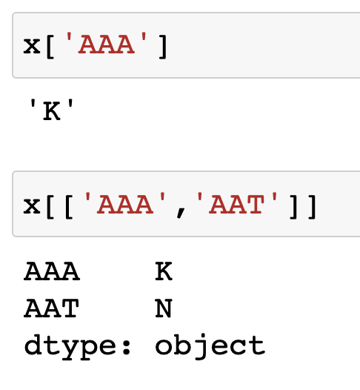
Pandas-Series
Accessing elements in Series:
specific elements can be selected by providing their indexes

Slide 31
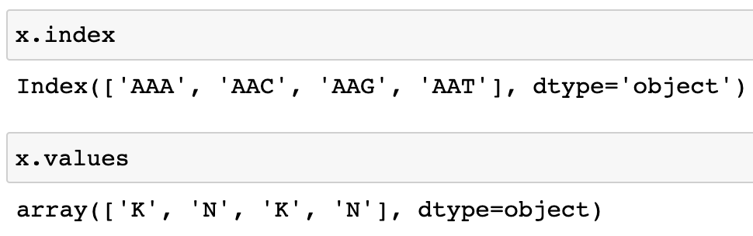
Pandas-Series
Accessing index and values in Series:

Slide 32
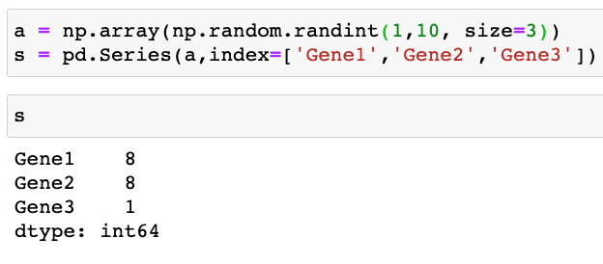
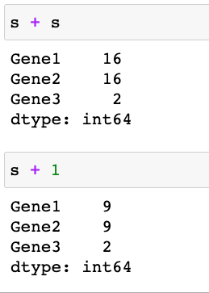
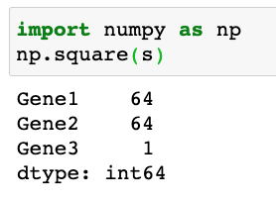
Pandas-Series
Vectorized operations and label alignment with Series
Series can also be passed into most NumPy methods

Slide 33
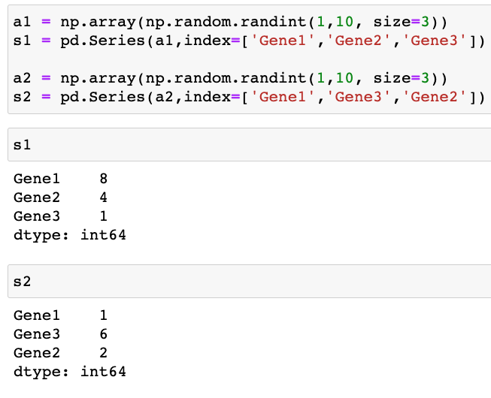
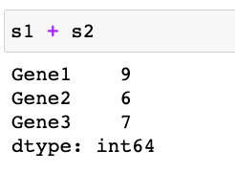
Pandas-Series
Vectorized operations and label alignment with Series
A key difference between Series and ndarray is that operations between Series automatically align the data based on label.

Slide 34
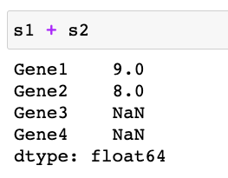
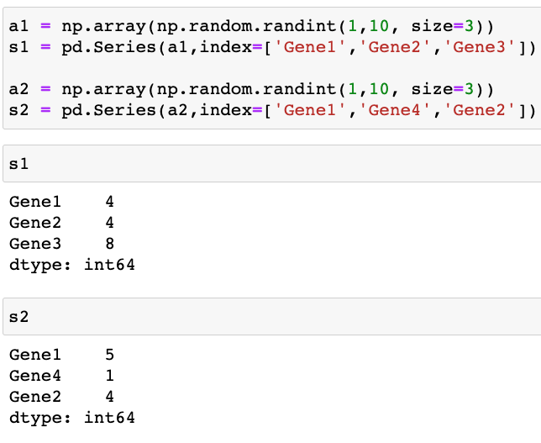
Pandas-Series
Vectorized operations and label alignment with Series
The result of an operation between unaligned Series will have the union of the indexes involved. If a label is not found in one Series or the other, the result will be marked as missing NaN

Slide 35
Pandas-DataFrame
DataFrame is a 2-dimensional labeled data structure with columns of potentially different types. It is generally the most commonly used pandas object.
DataFrame has two different labels i.e. index (row labels) and columns (column labels)
DataFrames can be created using pd.DataFrame() method.

Slide 36
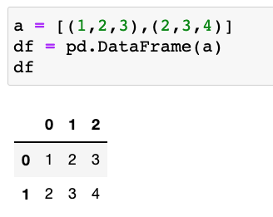
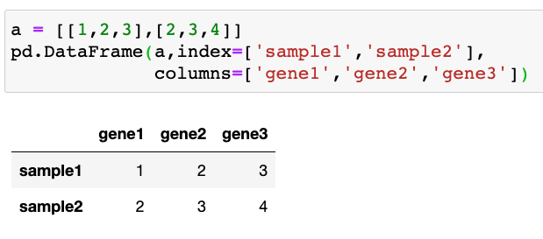
Creating DataFrames
pd.DataFrame(data, (index, columns))
From dict/list of ndarrays / lists / tuples / dict
The ndarrays/lists must all be the same length. If an index is passed, it must also be the same length as the arrays. If no index is passed, the result will be range(n), where n is the array length.

Slide 37
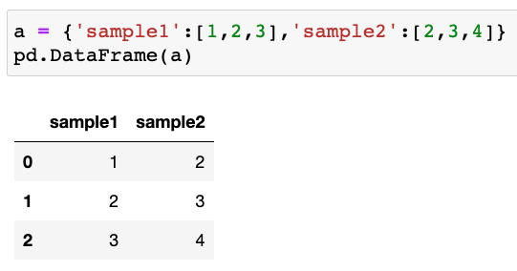
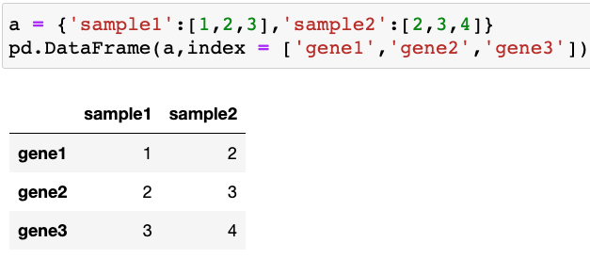
Creating DataFrames
pd.DataFrame(data, (index, columns))
From dict/list of ndarrays / lists / tuples / dict

Slide 38
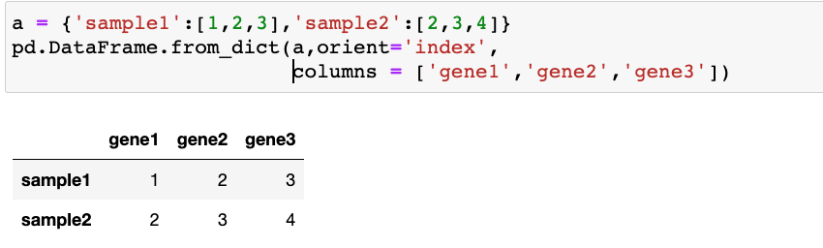
Creating DataFrames
pd.DataFrame.from_dict(data, orient = ‘columns’)
From dict/list of ndarrays / lists / tuples / dict
orient : {'columns', 'index'}, default 'columns’
The "orientation" of the data. If the keys of the passed dict should be the columns of the resulting DataFrame, pass 'columns' (default). Otherwise if the keys should be rows, pass 'index'.

Slide 39
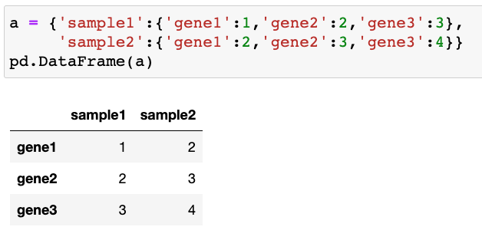
Creating DataFrames
From dict/list of ndarrays / lists / tuples / dict

Slide 40
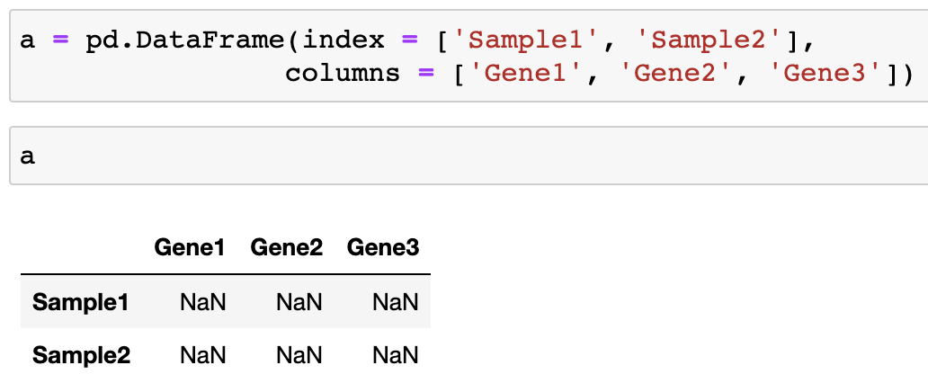
Creating DataFrames
We can also create a DataFrame with empty columns and fill in the data later:

Slide 41
Create DataFrames from files
Format Type | Data Description | Reader | Writer
binary | MS Excel | read_excel | to_excel
binary | OpenDocument | read_excel
binary | HDF5 Format | read_hdf | to_hdf
binary | Feather Format | read_feather | to_feather
binary | Parquet Format | read_parquet | to_parquet
binary | ORC Format | read_orc
binary | Stata | read_stata | to_stata
binary | SAS | read_sas
binary | SPSS | read_spss
binary | Python Pickle Format | read_pickle | to_pickle
SQL | SQL | read_sql | to_sql
SQL | Google BigQuery | read_gbq | to_gbq
Reading and writing files
Format Type | Data Description | Reader | Writer
text | CSV | read_csv | to_csv
text | Fixed-Width Text File | read_fwf
text | JSON | read_json | to_json
text | HTML | read_html | to_html
text | LaTeX |  | Styler.to_latex
text | XML | read_xml | to_xml
text | Local clipboard | read_clipboard | to_clipboard
https://pandas.pydata.org/pandas-docs/stable/user_guide/io.html

Slide 42
Create DataFrames from files
read_csv (filepath, sep=’,’ , header = ‘infer’, names = None, index_col = None,…)
filepath: a path to a file
sep: Delimiter to use; ’ , ’ for CSV, ‘ \t ’ for tab-delimited file
header: Row number(s) to use as the column names. None if file contains no header row
names: List of column names to use
index_col: Column(s) to use as the row labels of the DataFrame, either given as string name or column index.

Slide 43
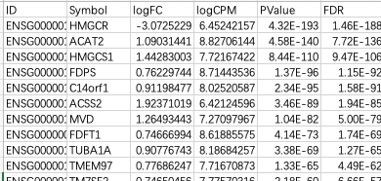
Create DataFrames from files
read_csv (filepath, sep=’,’ , header = ‘infer’, names = None, index_col = None,…)
RNA_seq_results.csv

Slide 44
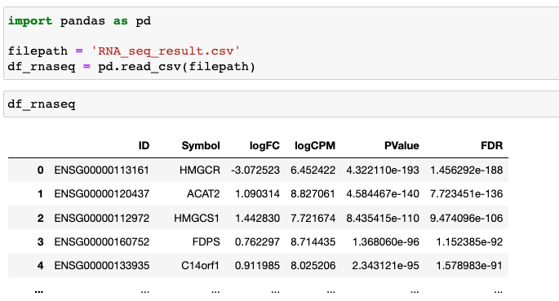
Create DataFrames from files
read_csv (filepath, sep=’,’ , header = ‘infer’, names = None, index_col = None,…)

Slide 45
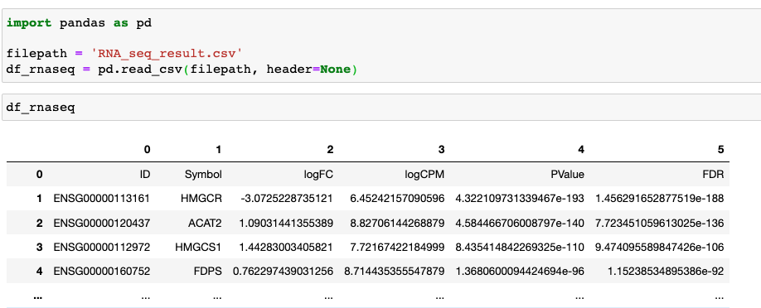
Create DataFrames from files
read_csv (filepath, sep=’,’ , header = ‘infer’, names = None, index_col = None,…)

Slide 46
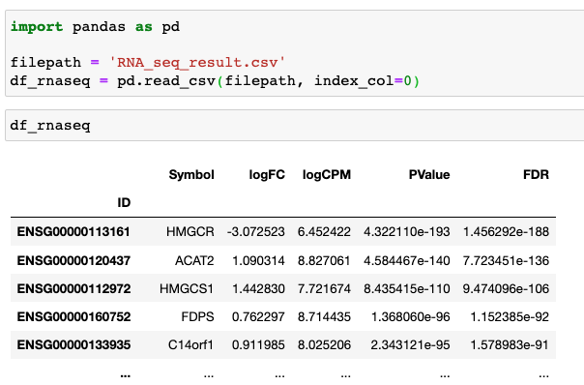
Create DataFrames from files
read_csv (filepath, sep=’,’ , header = ‘infer’, names = None, index_col = None,…)

Slide 47
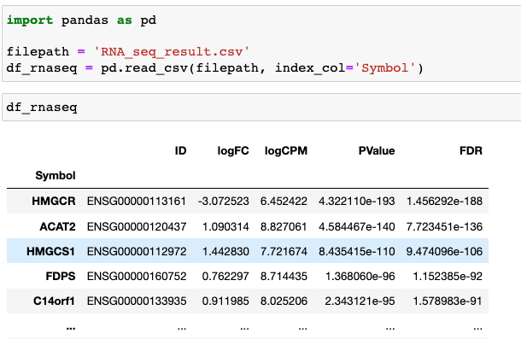
Create DataFrames from files
read_csv (filepath, sep=’,’ , header = ‘infer’, names = None, index_col = None,…)

Slide 48
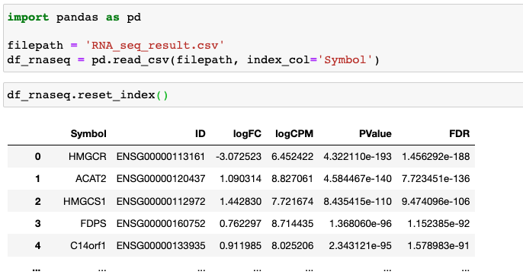
Create DataFrames from files
read_csv (filepath, sep=’,’ , header = ‘infer’, names = None, index_col = None,…)
reset_index()
Reset the index of the DataFrame

Slide 49
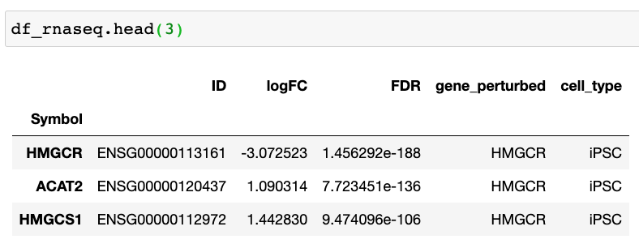
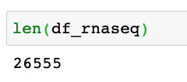
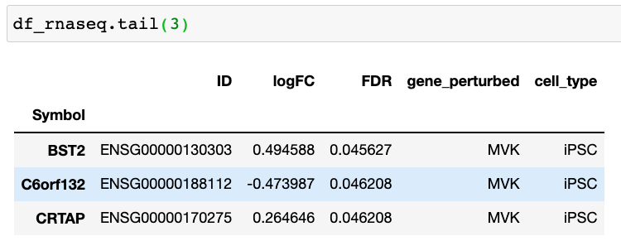
View DataFrames
Use DataFrame.head(n) and DataFrame.tail(n) to view the top and bottom n rows of the frame, respectively.

Slide 50

Save DataFrames to files
DataFrame.to_csv (filepath, sep=’,’ , header = True, index = True, …)
sep : str, default ‘,’ ; ‘\t’ for tab-delimited file
header : bool or list of str, default True. Write out the column names. If a list of strings is given it is assumed to be aliases for the column names.
index : bool, default True. Write row names (index).

